Slide 1
SenseComm: mmWave Tags for 5G-based Sensing
Under the supervision of
Dr. Ish Jain
Presenter(s): Swastik Kanjilal & Adithya Vijayan
Notes:
Hi everyone, I’m Swastik, and this is Adithya.
We’re from WaYS Lab at RPI, working with Dr. Ish Jain.
Today we’ll talk about SenseComm – using 5G base stations as radars to detect special mmWave tags in bad visibility.

Slide 2
TABLE OF CONTENTS
Why Do We Want A Mmwave Tag?...................................................... | 3
From R-Fiducial → SenseComm......................................................... | 4
Hypothesis....................................................................................... | 5
Em Sim Results................................................................................. | 6
Methodology..................................................................................... | 8
Ofdm Simulation............................................................................... | 9
Why Gold Codes?.............................................................................. | 10
Hardware.......................................................................................... | 11
References....................................................................................... | 12
Demonstration.................................................................................. | 13

Slide 3
WHY do we want a mmWave Tag?
Traditional sensors struggle in fog, dust, and rain.
mmWaves are scattered easily.
We need a higher FoV to reliably identify infrastructure from far away
Tx
Tag
Rx
Notes:
Imagine a car on a mountain road in fog: the camera can’t see the ‘sharp-turn’ sign, but radar still works.
But mmWave signals can still propagate – they just scatter a lot, so it’s hard to reliably pick out infrastructure at long range. Our idea is to mount radar-friendly tags on infrastructure – for example, traffic signs or roadside units.
These tags are designed so that a radar sees them very clearly, giving us a high field of view and reliable detection even when optics fail.
So the big question is: can we make existing 5G base stations act like these radars for tags?

Slide 4
FROM R-FIDUCIAL → SENSECOMM
reusing 5G downlink OFDM instead of a dedicated FMCW radar.
R-fiducial: 24 GHz FMCW radar + custom van-Atta tags for traffic/fire infrastructure.
Our twist: 5G gNB downlink OFDM as the radar waveform (no new hardware/waveform).
Goal: make 5G base stations “see” infrastructure tags in fog / smoke.
Notes:
This builds on R-fiducial, which used a dedicated 24 GHz FMCW radar plus Van-Atta reflector tags for traffic infrastructure.
The radar sends chirps, the tags retro-reflect them, and the radar can localize those tags very robustly in traffic scenes. What we plan in SenseComm is change one key piece: instead of a dedicated radar and a custom waveform, we reuse the 5G downlink OFDM that the base station is already transmitting.
So the 5G gNB becomes our radar transmitter, and our tags are designed to reflect and modulate that waveform.

Slide 5
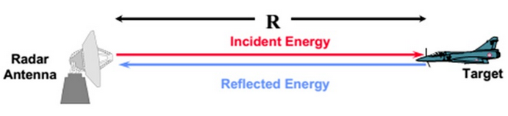
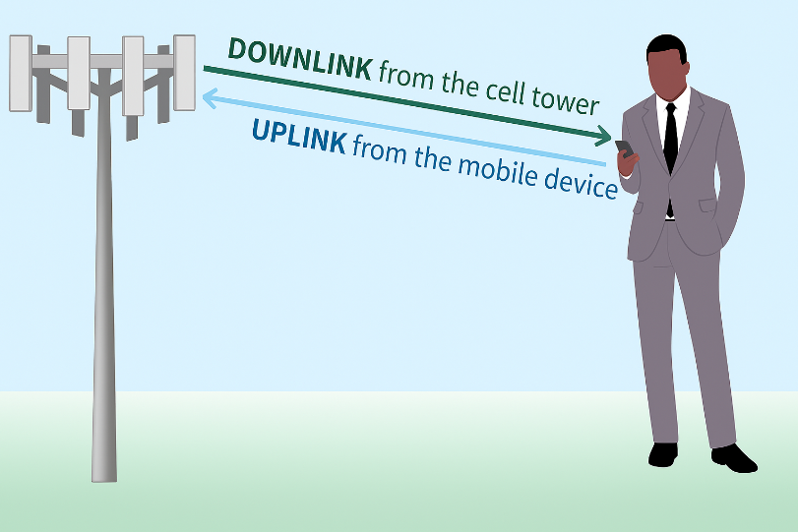
HYPOTHESIS
Uplink: The base station (BS) receives data and requests from the user equipment (UE).
Downlink: The BS transmits OFDM downlink waveforms to serve the UE.
These downlink signals naturally reflect off objects in the environment.
A fraction of this energy returns to the BS, where it is captured by sensing antennas.
This enables radar-like sensing using the same communication waveforms, without extra hardware, new waveforms, or additional modalities.
= mmwave tags
Notes:
To make that concrete, here is our hypothesis.
In the uplink, the base station receives normal data and control from the user equipment – that’s standard. In the downlink, the base station sends OFDM waveforms to serve the user.
Those downlink signals naturally bounce off objects in the environment – buildings, cars, signs – and a fraction of that energy comes back to the base station.
If we add a few extra sensing antennas at the base station and process those reflected signals carefully, we can do radar-like sensing using the exact same downlink communication waveform.
So: no new spectrum, no extra transmitter – just smarter signal processing and special tags.

Slide 6
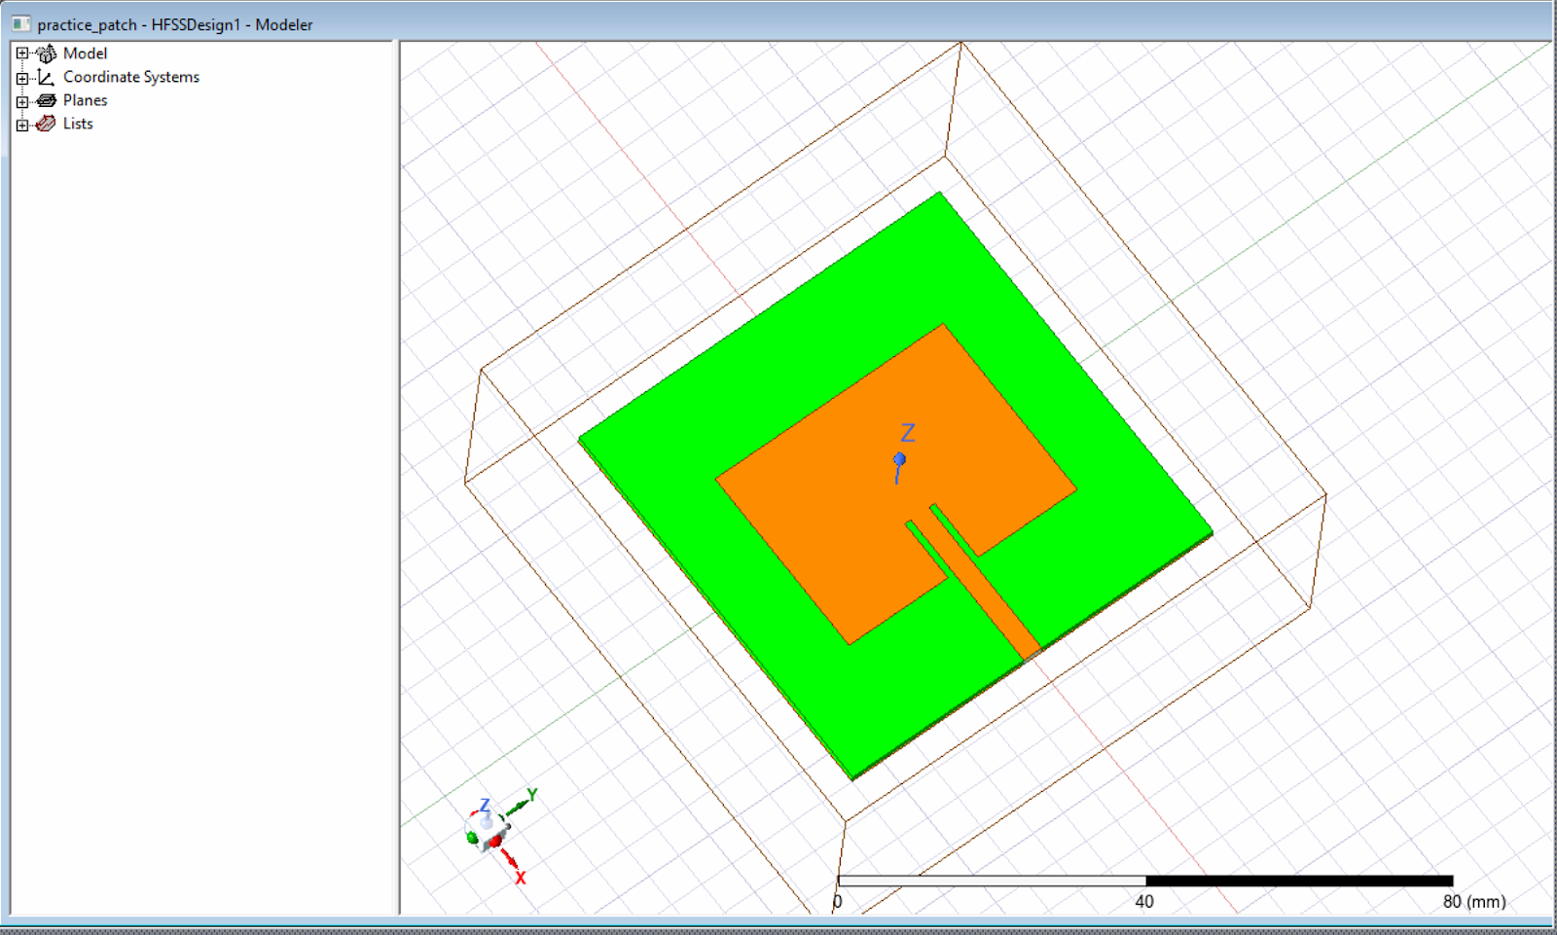
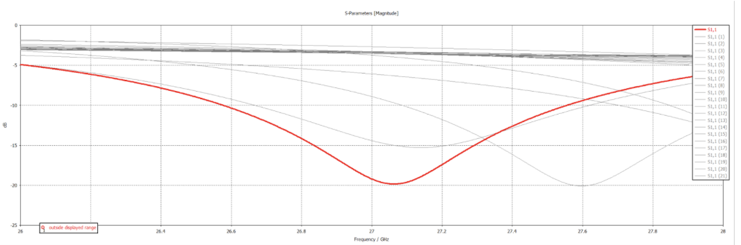
EM SIMULATION RESULTS
27 GHz patch antenna
27 GHz S11 plot reflection (patch antenna
Notes:
Patch tuned around 27 GHz with |S11| < –10 dB → good radiator / reflector at design frequency.

Slide 7
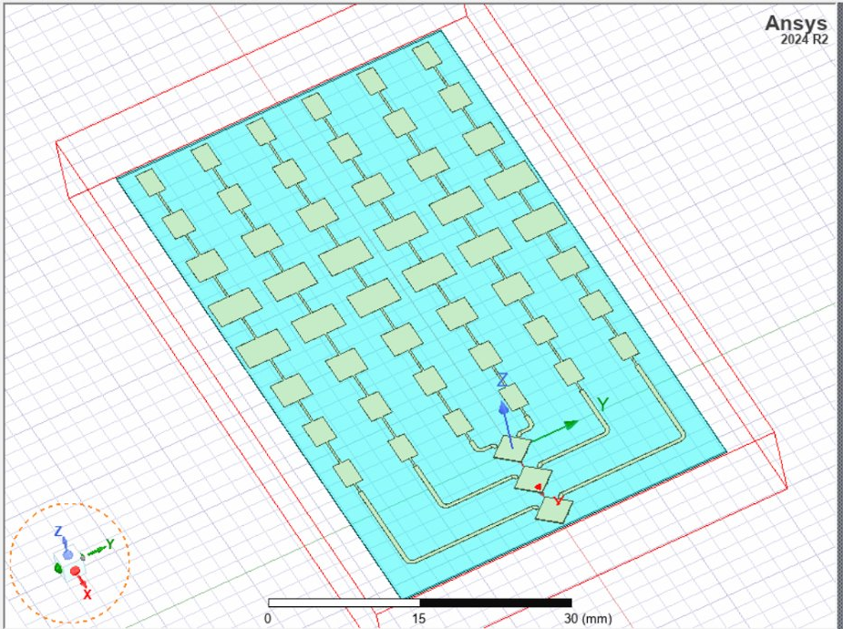
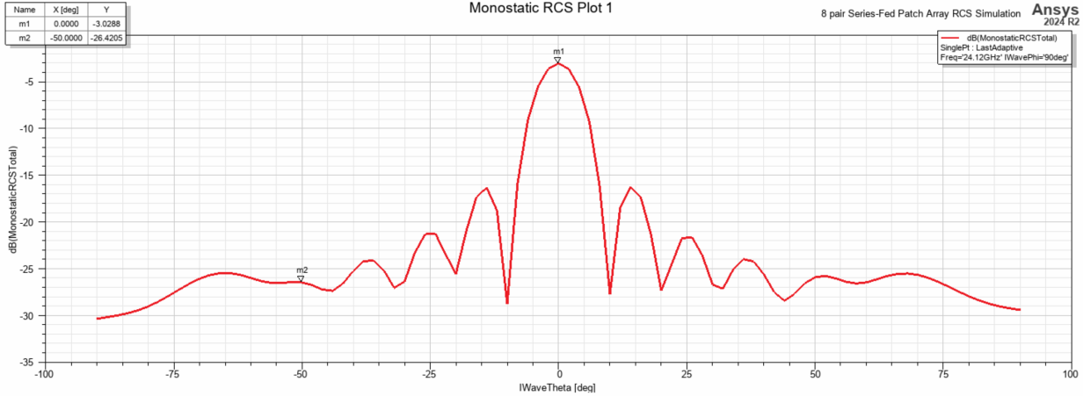
EM SIMULATION RESULTS (CONTD.)
Van-Atta Array​
Monostatic plot of Van-Atta Array​
Notes:
This is the monostatic plot of our Van-Atta Array in HFSS --> showing a peak at 0 degrees where our incident wave is coming from
Monostatic RCS plot shows strong retro-reflection over wide angle, unlike a flat metal plate → large FOV.

Slide 8
METHODOLOGY
Tx
Tag
Rx
Scatterer
monostatic setup
Baseline (no tag): only the direct reflected path from TX to RX
y = h_{d}.x+ n
Next the equation for our tag reflected path is:
y = h_{d}.x + b̂.h_{t}.x+n
Multiply Gold Codes at the tags (alongside the Tag modulated data) and the RX to decode the tag (sensing) data.
Gold codes are built by XOR-ing two m-bit LFSRs (linear-feedback shift registers).
Correct tag code ---> strong autocorrelation peak; others ---→ suppressed
Capacity ≈ 2^{m/2} for an m-bit LFSR
Total number of Gold codes = 2^{m} + 1
Auto-correlation peak = 2^{m} − 1
Worst-case cross-correlation peak = 2^{(m+2)/2} + 1
E.g., With m = 5 bit LFSRs → 31-bit Gold codes.
Capacity ≈ 2^(5/2) = 2^2.5 ≈ 5.6 → effectively 4–5 simultaneous tags.
Notes:
Here’s how we model it. We use a monostatic setup: transmit and receive are co-located at the base station.
Baseline case – no tag: the received signal is y = h_d · x + n, where x is the downlink OFDM signal, h_d is the clutter channel from the environment, and n is noise.
With a tag present: the tag creates an extra path with channel h_t, scaled by some factor b-hat from the tag design. So the received signal becomes y = h_d · x + b-hat · h_t · x + n.
..........................................
The trick is: our tags multiply the incoming downlink signal by a Gold code, and at the base station we correlate with that code.
If we correlate with the correct code, we get a strong autocorrelation peak from the tag path. For other codes, the cross-correlation stays low, so those paths get suppressed.
This means each tag can have its own codeword, and in principle we can support multiple tags simultaneously in the same scene.”

Slide 9
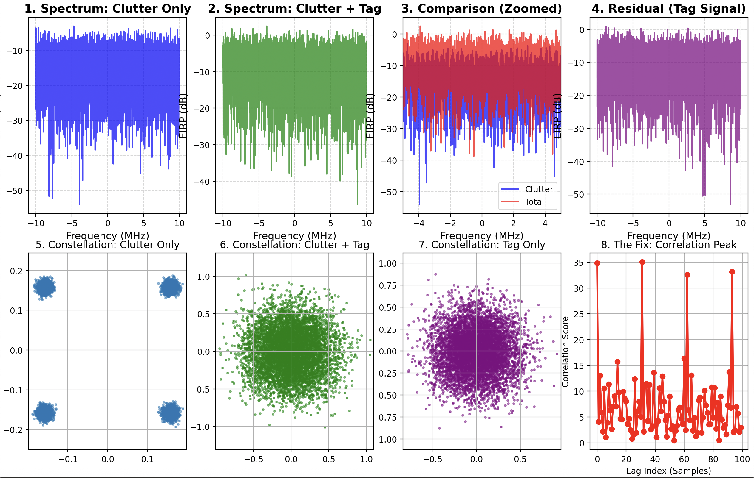
OFDM SIMULATION
tag makes clutter pop out
Showing power with just direct path, direct path + tag, and then only tag
Here, we see an increase in 5.57 dB with the addition of the tag
Notes:
SNR shot up but noise also amplified
Here we show a simple OFDM simulation to illustrate that effect.
On the left, we plot the power spectrum when we only have the direct clutter path – there’s no tag present.
In the middle, we add the tag path. Visually, it still looks like clutter; the tag is weak and buried in the environment.
On the right, we apply our clutter suppression and correlation with the correct Gold code. Now the tag component pops out, giving roughly 5.6 dB gain compared to the clutter-only case.
So even though the tag is relatively weak, with coding plus correlation we can reliably detect it on top of the 5G downlink.

Slide 10
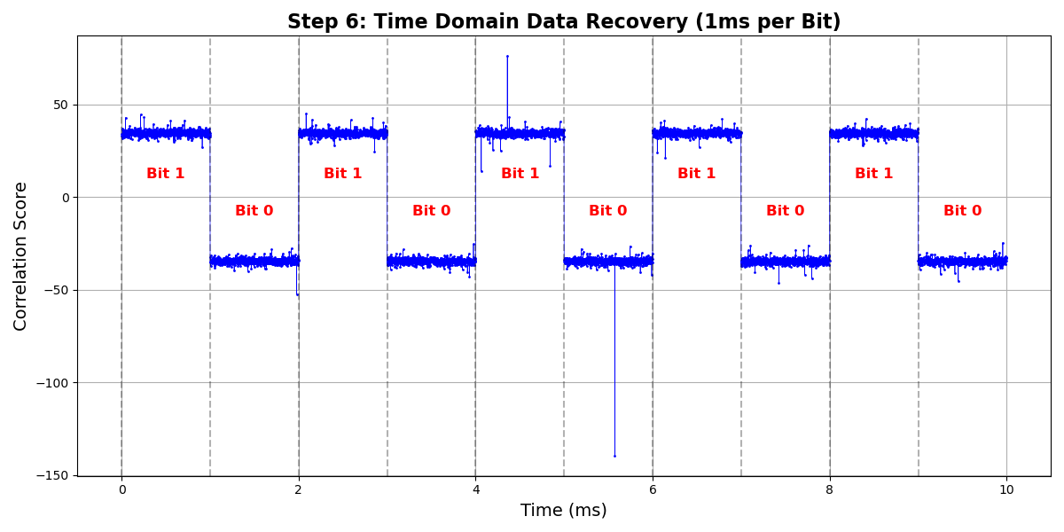
WHY GOLD CODE?
Here we used a data switching rate of 1ms and a sampling frequency of 20Mhz
This corresponds to 20,000 samples
So, for each chunk of the 10 bits, we have 645 repetitions of the 31 bit gold code (20,000/31)
Notes:
Next, I wanted to talk about the tag modulation and gold codes. Firstly, what are gold codes? Gold codes special binary sequences with excellent autocorrelation and cross-correlation properties, crucial for distinguishing signals in spread-spectrum systems. So for example, if our tag was modulating a sequence of bits that was 1 0 1 0 1 0 1 0 1 0 (10 bits), we would first use spread spectrum coding, which means I would multiply (but in real life more like reflecting highly for 1 and lowly for 0) the first bit with each bit of the gold code, where 1 correlates to +1 and 0 correlates to –1. Then on the receiver side, we multiply by this gold code again, and sum the numbers up. Since, the tag signal is correlated with the gold code already, the positive values will be even more positive, and then negative values become even more negative. Additionally, the additional OFDM signal and noise gets cancelled out as they aren't correlated with the gold codes.

Slide 11
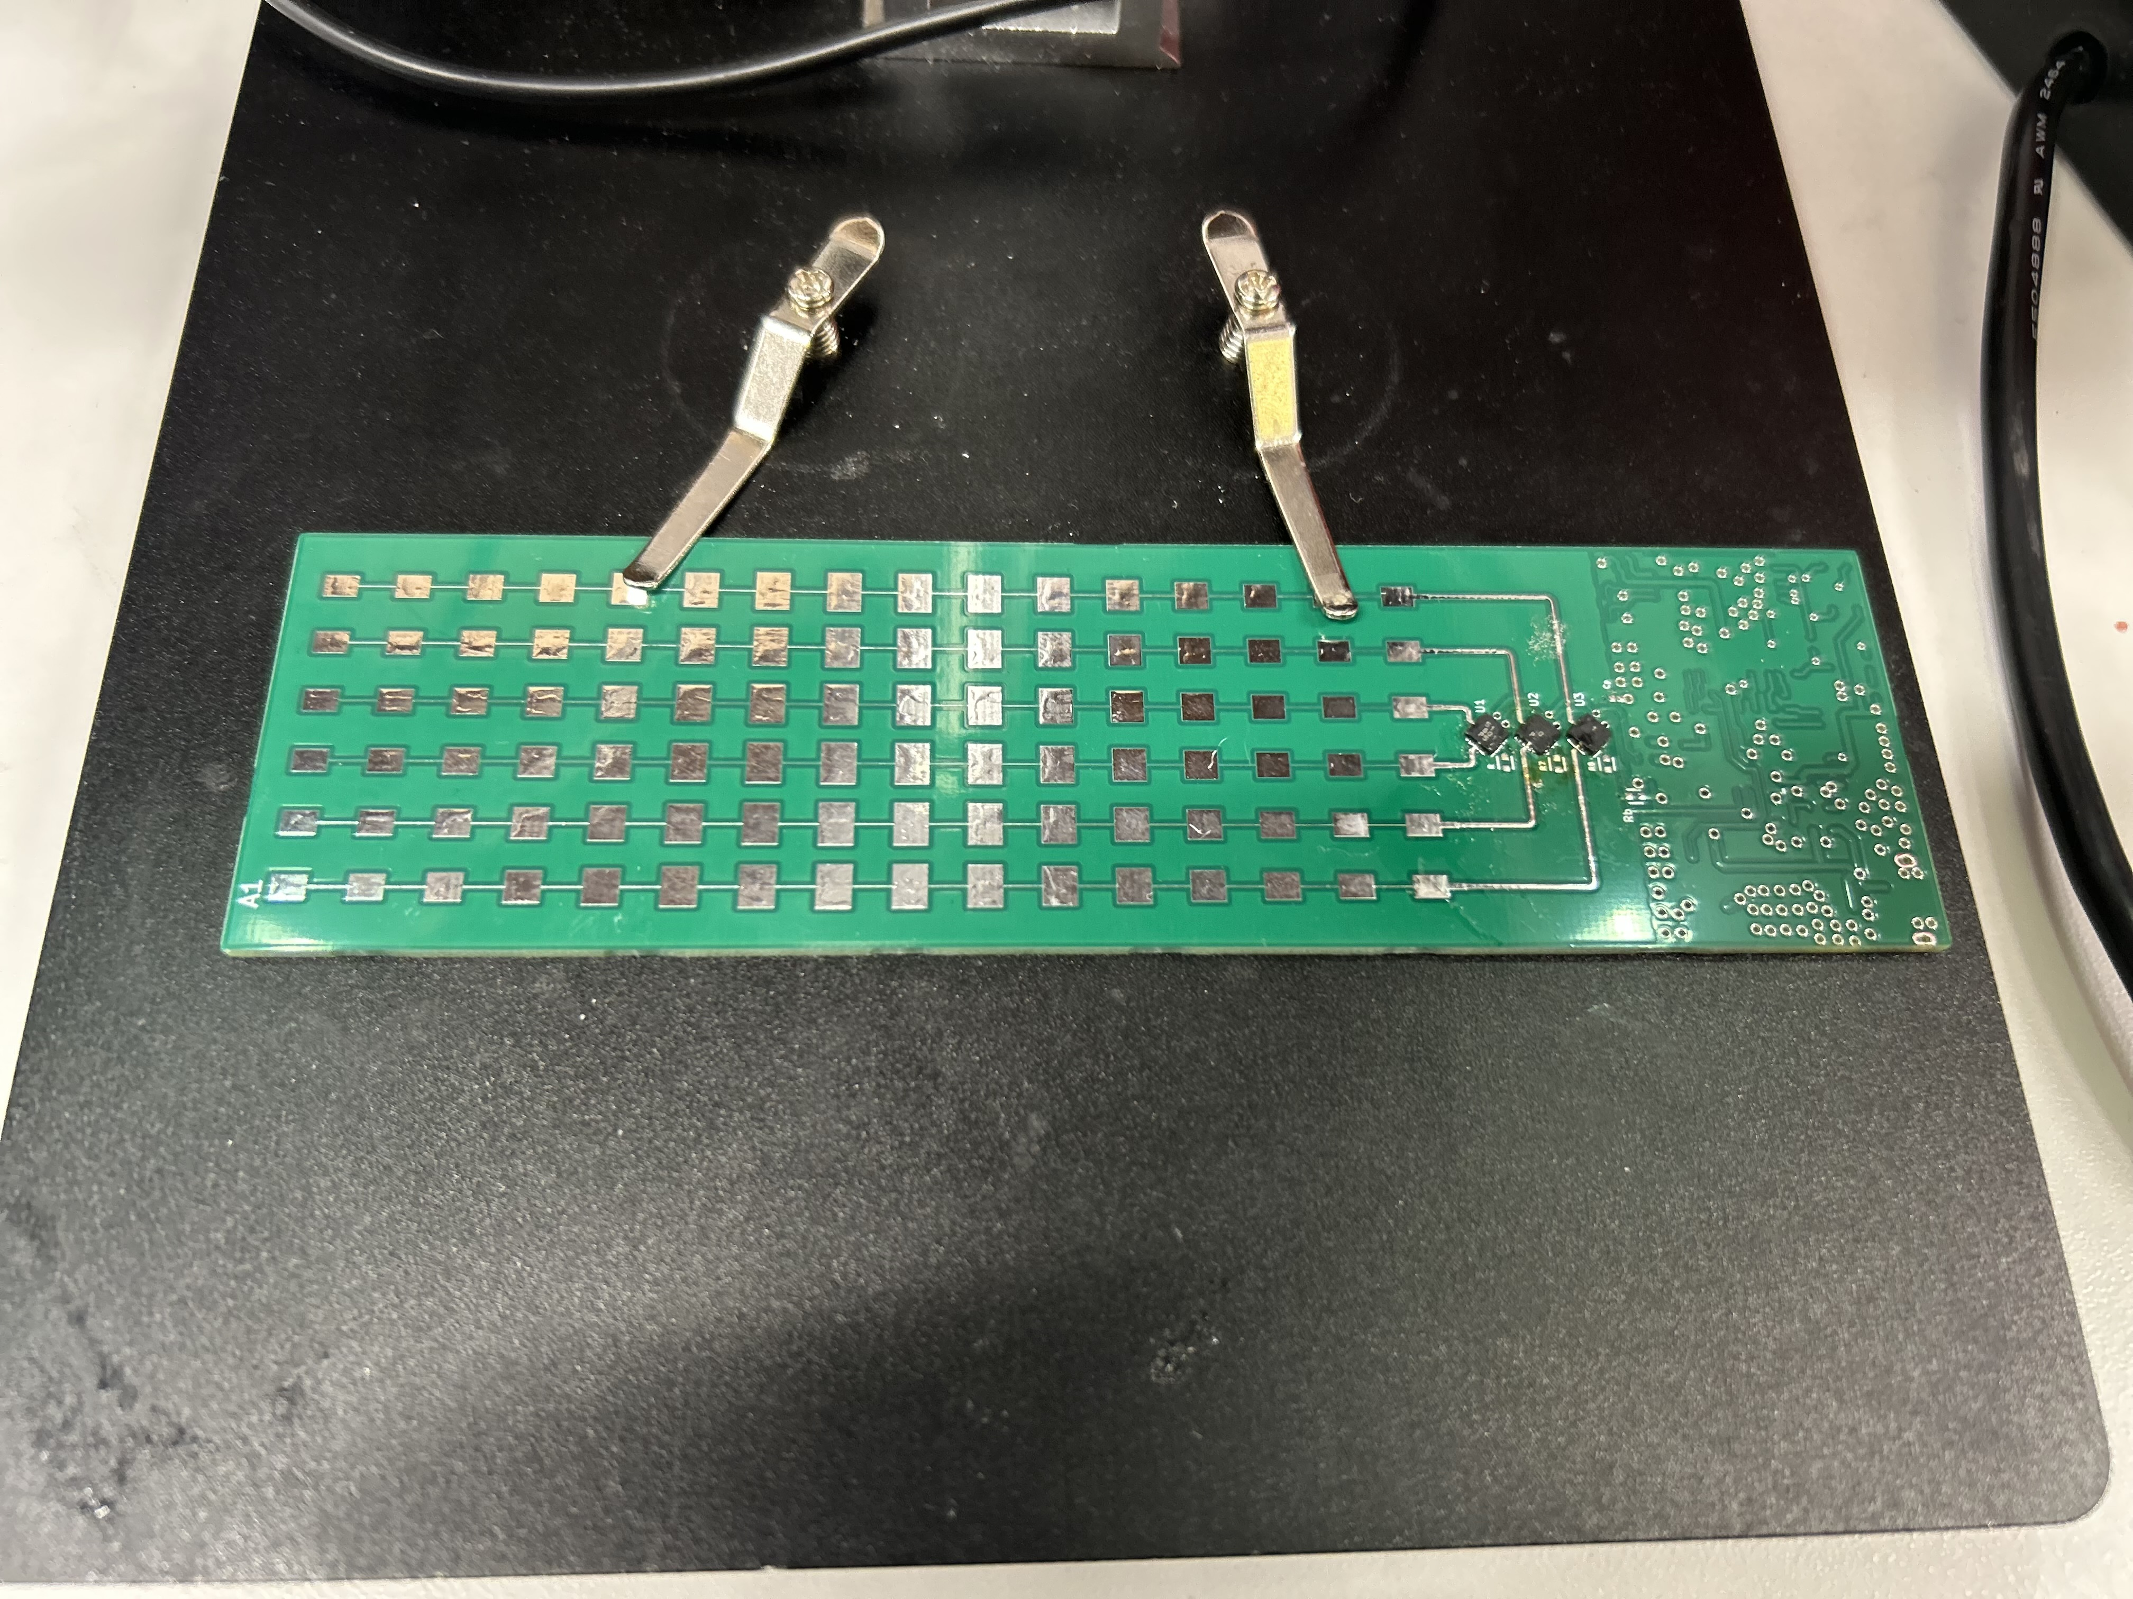
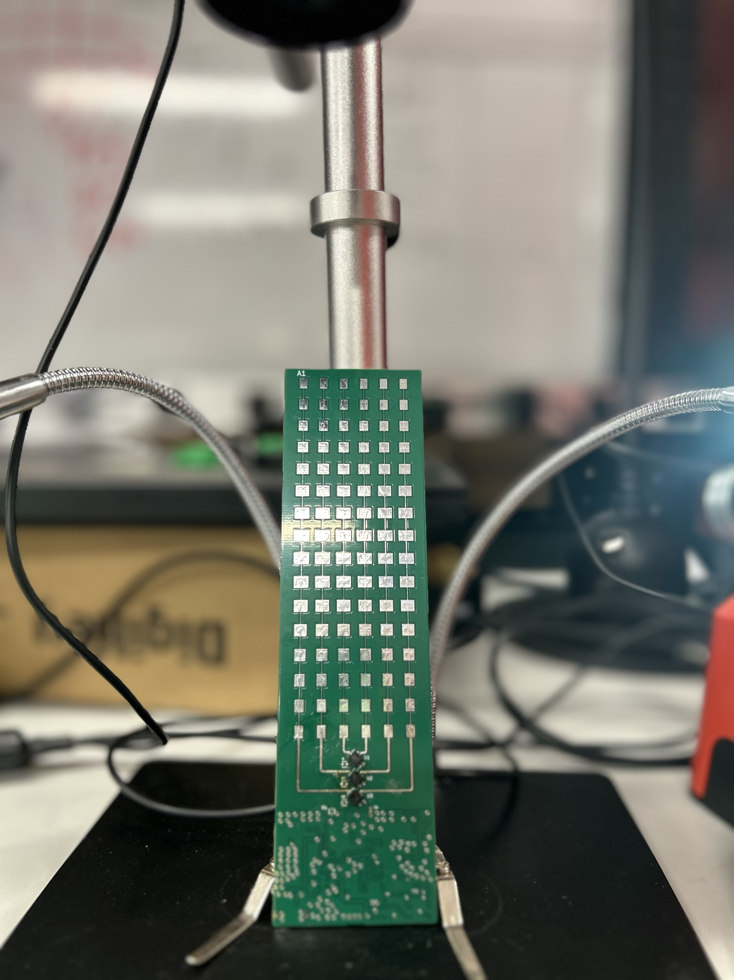
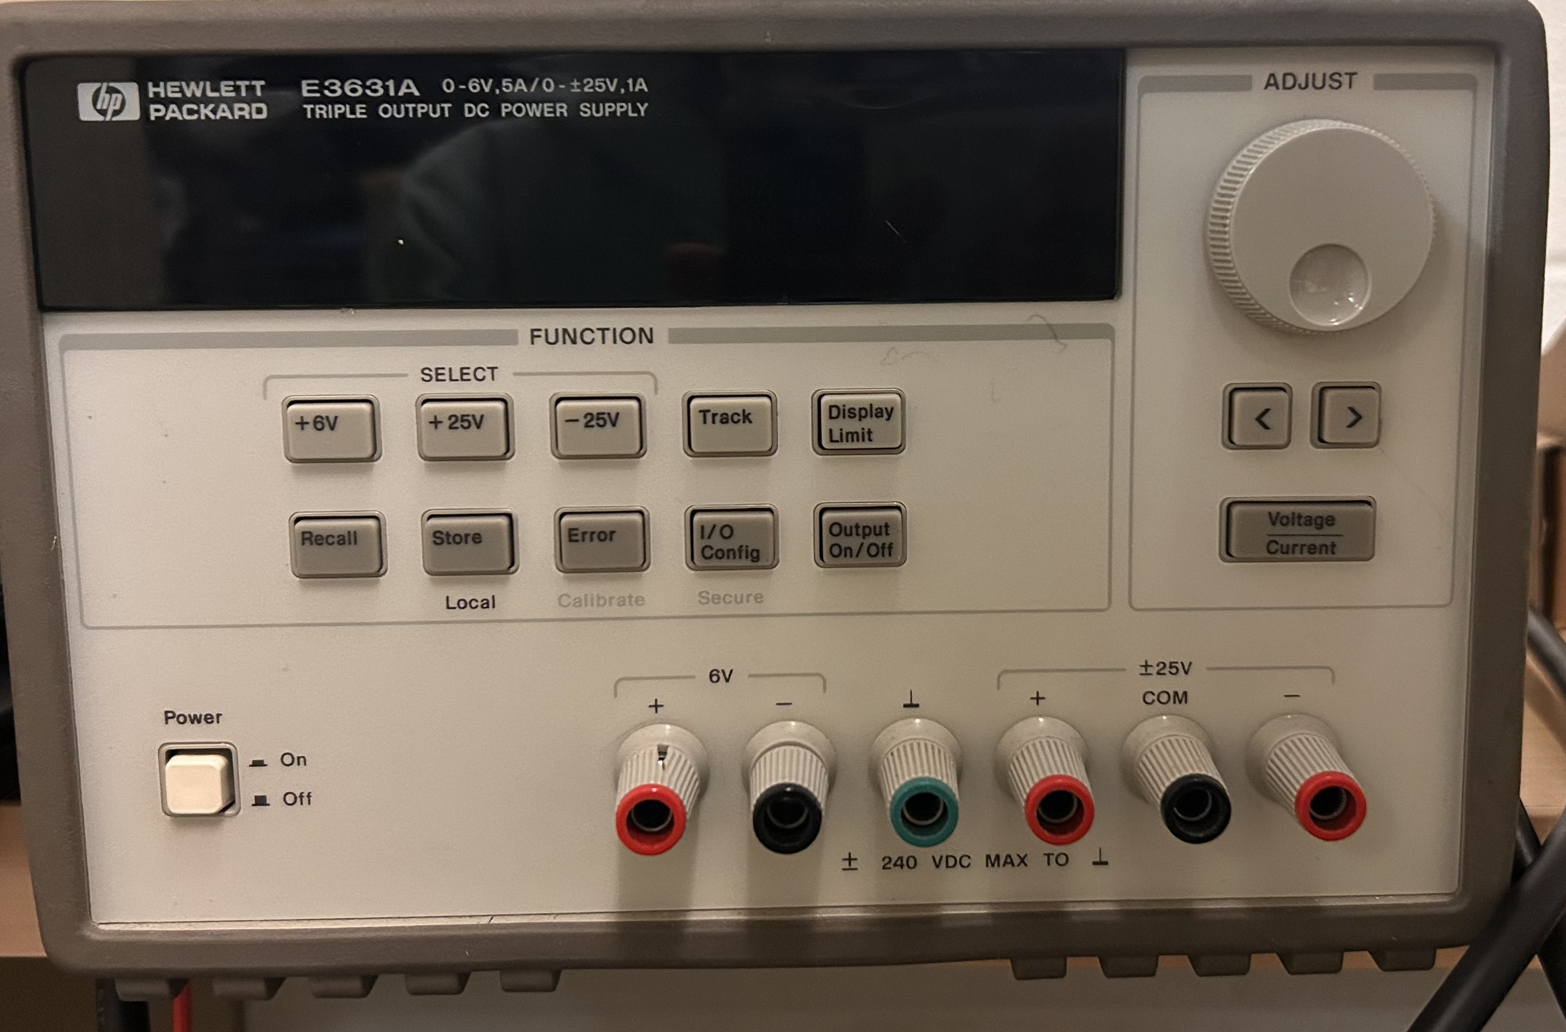
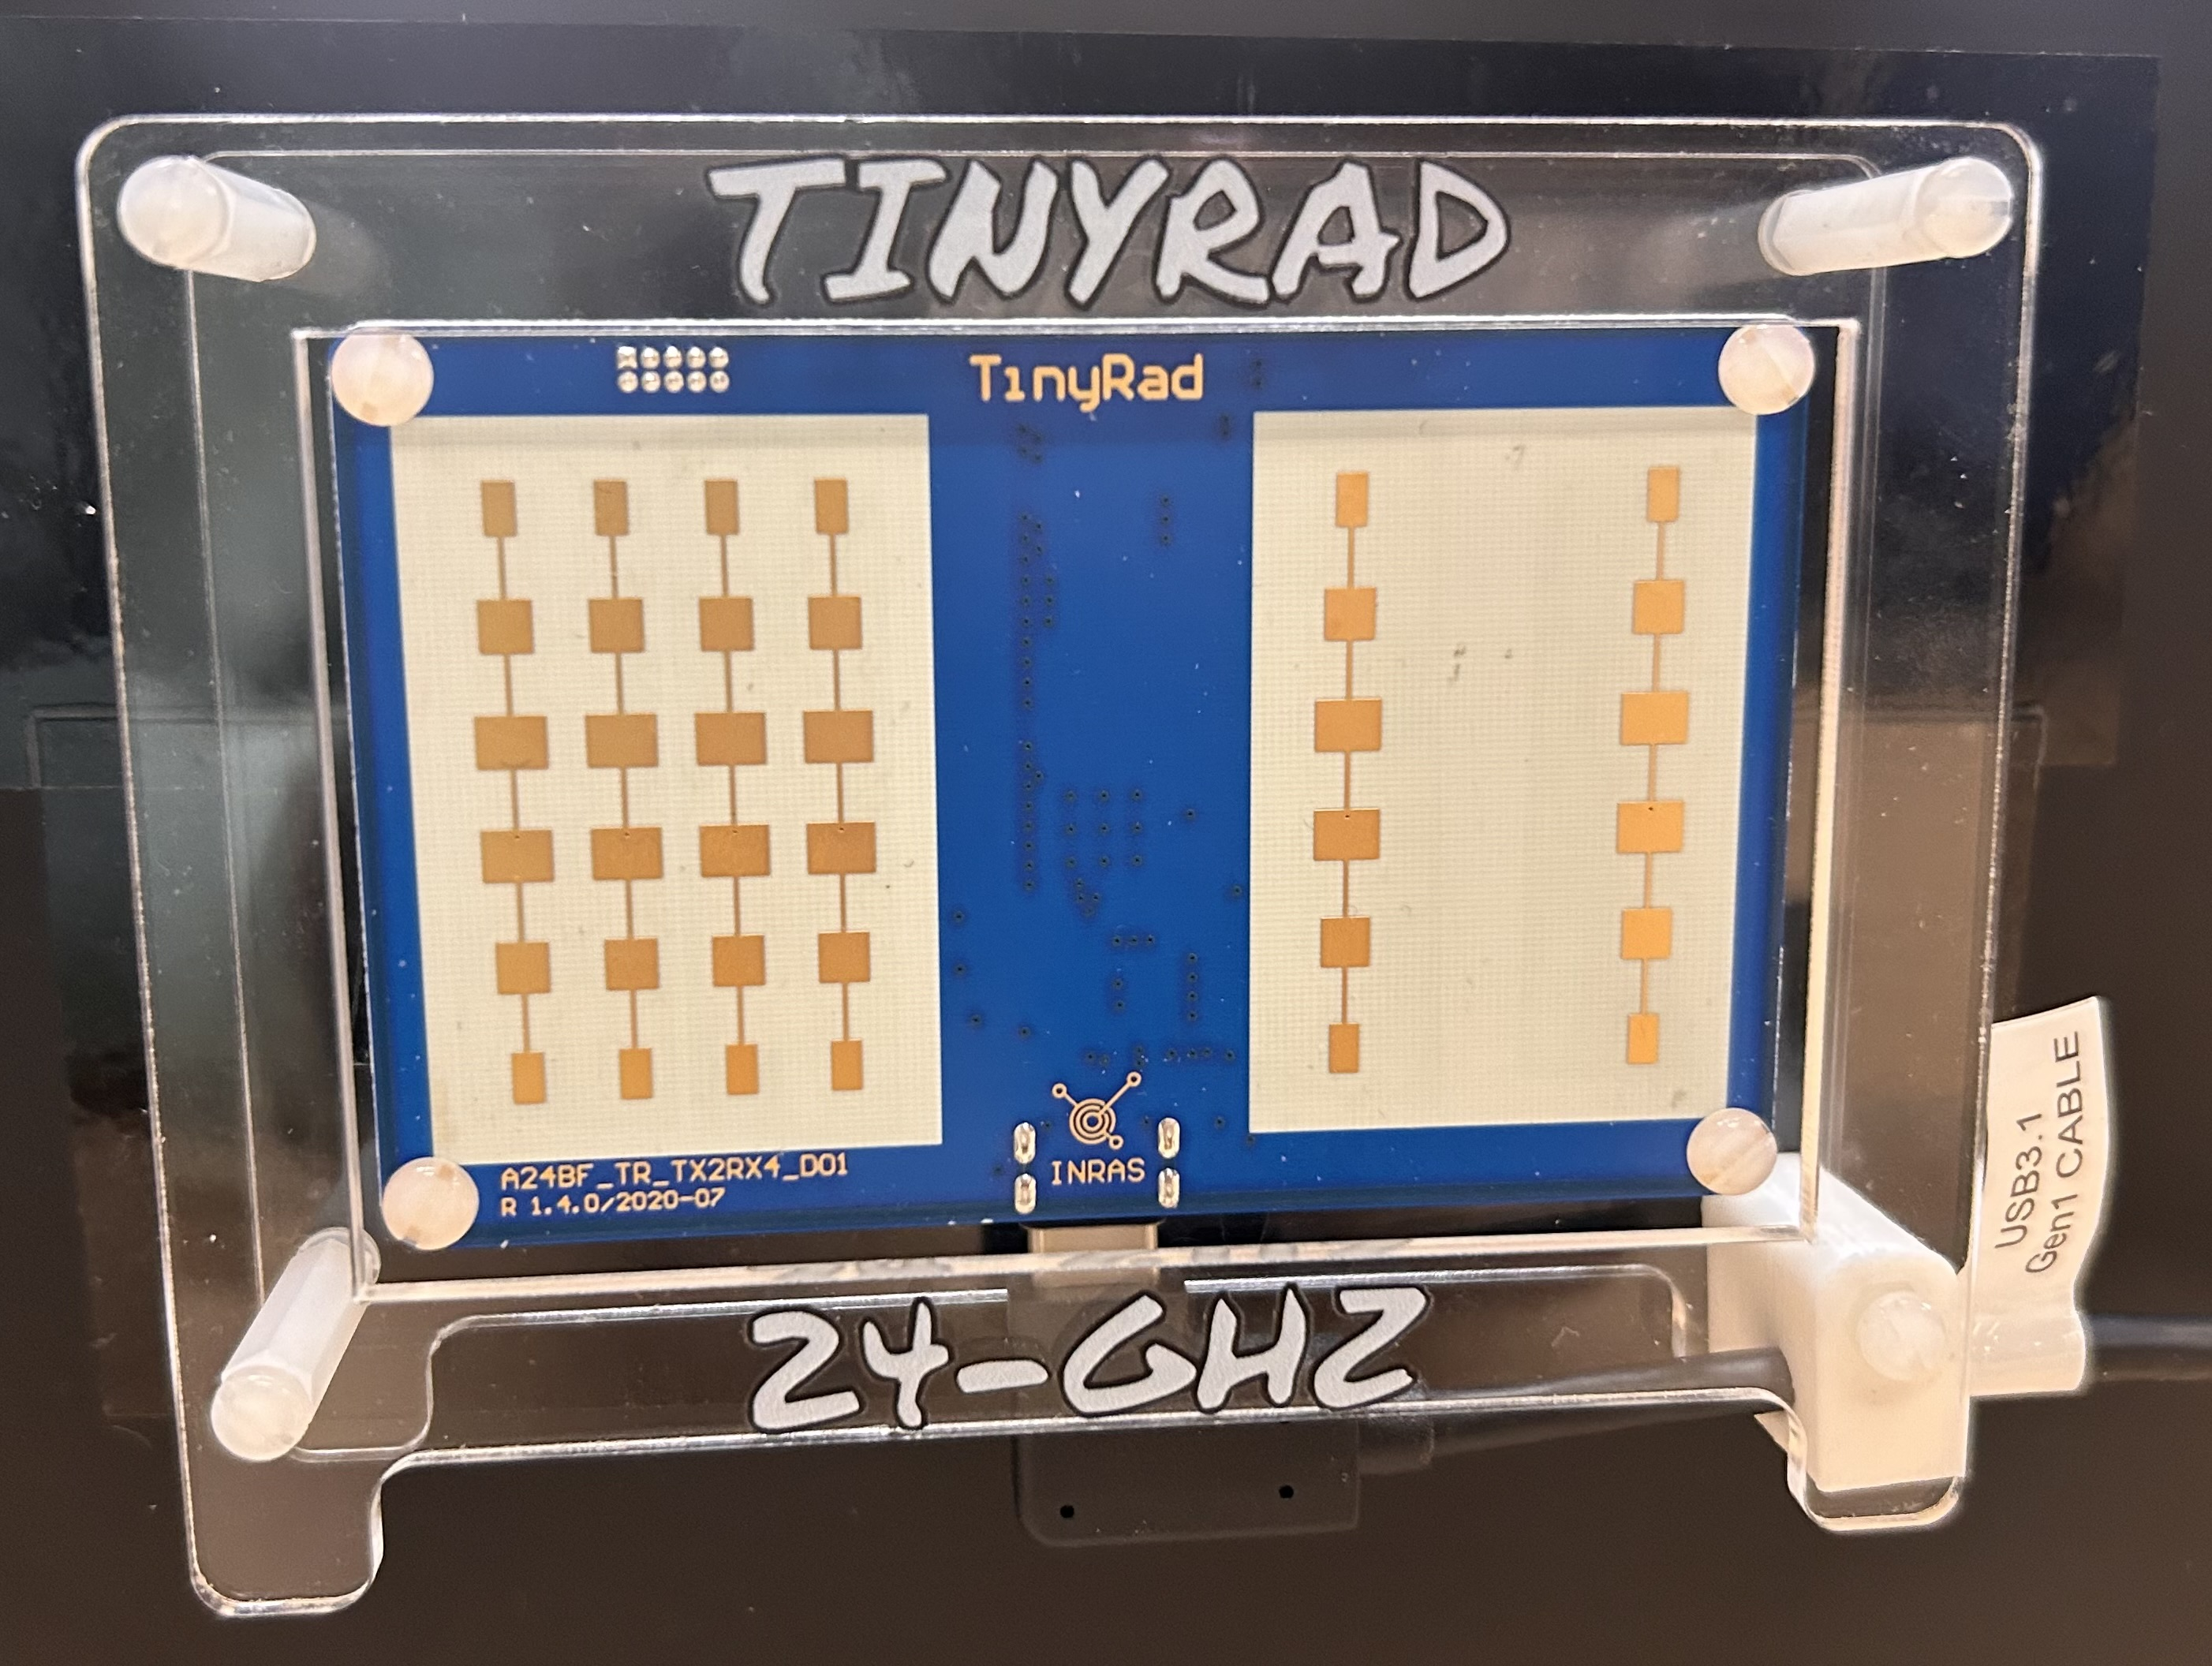
HARDWARE
Sense/ localize in low visibility
Using Analog Devices Radars
MmWave tags
VNA
Power Source
Resisters and Capacitors (SMDs)
Strong Scatterer
Notes:
We’ve also started building hardware to test this in practice.
For now, we’re using an Analog Devices 24 GHz radar as a stand-in for the future 5G base station.
We design mmWave tags – essentially Van-Atta-style arrays – that retro-reflect strongly back to the radar.
We characterize everything with a VNA, use a power source and SMD resistors and capacitors to tune the boards,
and we keep a strong scatterer in the scene for calibration.

Slide 12
REFERENCES
M. Dunna, K. Bansal, S. A. Ganesh, E. Patamasing and D. Bharadia, "R-fiducial: Millimeter Wave Radar Fiducials for Sensing Traffic Infrastructure," 2023 IEEE 97th Vehicular Technology Conference (VTC2023-Spring), Florence, Italy, 2023, pp. 1-7, doi: 10.1109/VTC2023-Spring57618.2023.10199374.
E. Sharp and M. Diab, “Van atta reflector array,” IRE Transactions on Antennas and Propagation, vol. 8, no. 4, pp. 436–438, 1960.
R. Gold, “Optimal binary sequences for spread spectrum multiplexing (corresp.),” IEEE Transactions on Information Theory, vol. 13, no. 4, pp. 619–621, 1967.
K. M. Bae, N. Ahn, Y. Chae, P. Pathak, S.-M. Sohn, and S. M. Kim, “Omniscatter: Extreme sensitivity mmwave backscattering using commodity fmcw radar,” in Proceedings of the 20th Annual International Conference on Mobile Systems, Applications and Services, ser. MobiSys ’22. New York, NY, USA : Association for Computing Machinery, 2022, p. 316–329
M. H. Mazaheri, A. Chen, and O. Abari, “mmtag: a millimeter wave backscatter network,” in Proceedings of the 2021 ACM SIGCOMM 2021 Conference, 2021, pp. 463–474.
Notes:
This is very early-stage work, and we’re developing it together with Curtis here at RPI and Nagarjun at UCSD, along with our advisor, Prof. Ish Jain.

Slide 13
THANK YOU! Ongoing work with Curtis (RPI), and Nagarjun Bhat (UCSD).

Slide 14
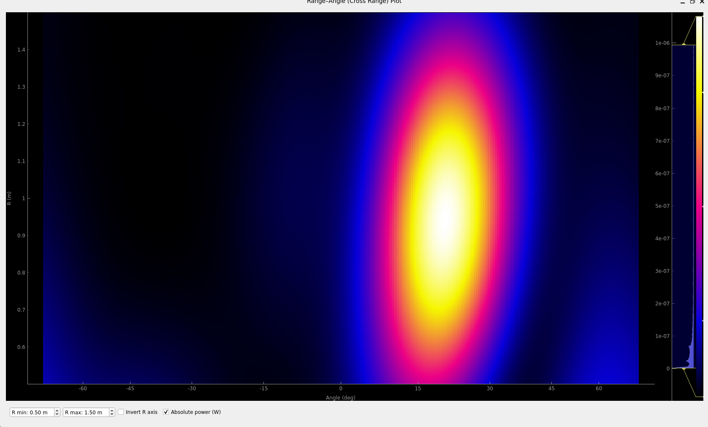
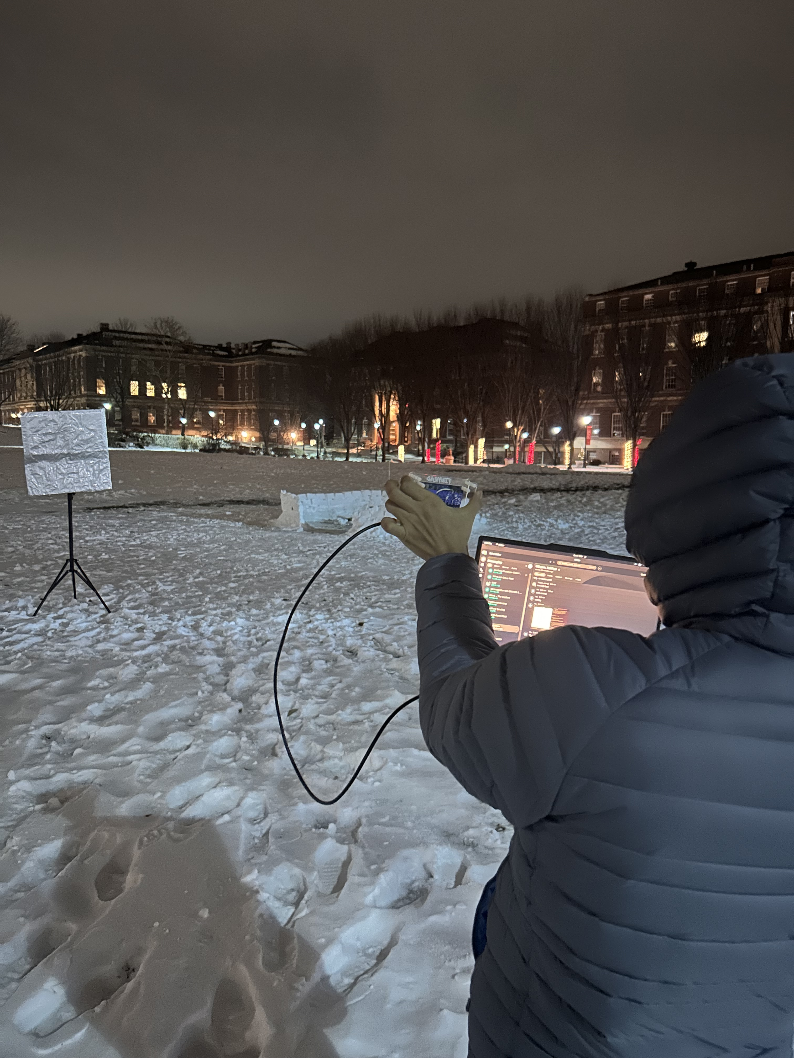
DEMONSTRATION
Notes:
To conclude, We’re reusing the 5G downlink OFDM as a radar waveform and attaching mmWave fiducial tags that strongly retro-reflect and code the signal. With Gold-code modulation and correlation at the base station, we can make 5G infrastructure visible in foggy or low-visibility conditions without adding new waveforms or hardware.
To close, here’s a quick look at a beam-sweep we did outside campus – the tag shows up as this strong lobe.
And here is the actual tag board we’re using; this will be our radar-visible ‘traffic sign’ in future tests

Slide 15
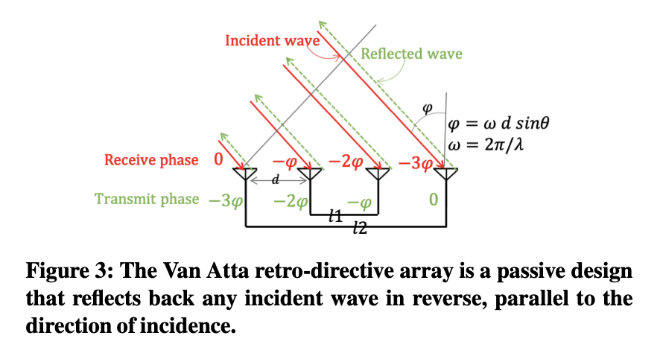
How does Van-Atta Work
It redirects signals exactly where they come from
It uses equal sized transmission lines.
Connected symmetrically so that the antenna element that receives the first incident wave transmits the signal of the opposite antenna element.

